Slide 1


Understanding Ecliptic Latitude and Longitude
Ecliptic latitude and longitude are essential celestial coordinates that enable the precise location of points within the solar system. They play a crucial role in comprehending the movements of celestial bodies relative to Earth, thereby aiding in navigation and the study of various astronomical events.

Slide 2




Ecliptic Coordinate System: Definitions and Basics
Ecliptic Coordinate System
Ecliptic Latitude
Ecliptic Longitude
This system is based on the plane of Earth's orbit around the Sun, known as the ecliptic plane.
This refers to the angular distance above or below the ecliptic plane, measured in degrees.
This defines a point's position along the ecliptic plane, measured in degrees from the vernal equinox.

Slide 3





Importance of Ecliptic Coordinates
2
Solar System Studies
These coordinates help in mapping the positions of planets and asteroids in relation to the Sun.
Astronomical Navigation
Ecliptic coordinates are crucial for astronomers to locate and track celestial bodies.
1
Influence on Seasons
Understanding ecliptic coordinates explains seasonal changes due to Earth's axial tilt.
3

Slide 4

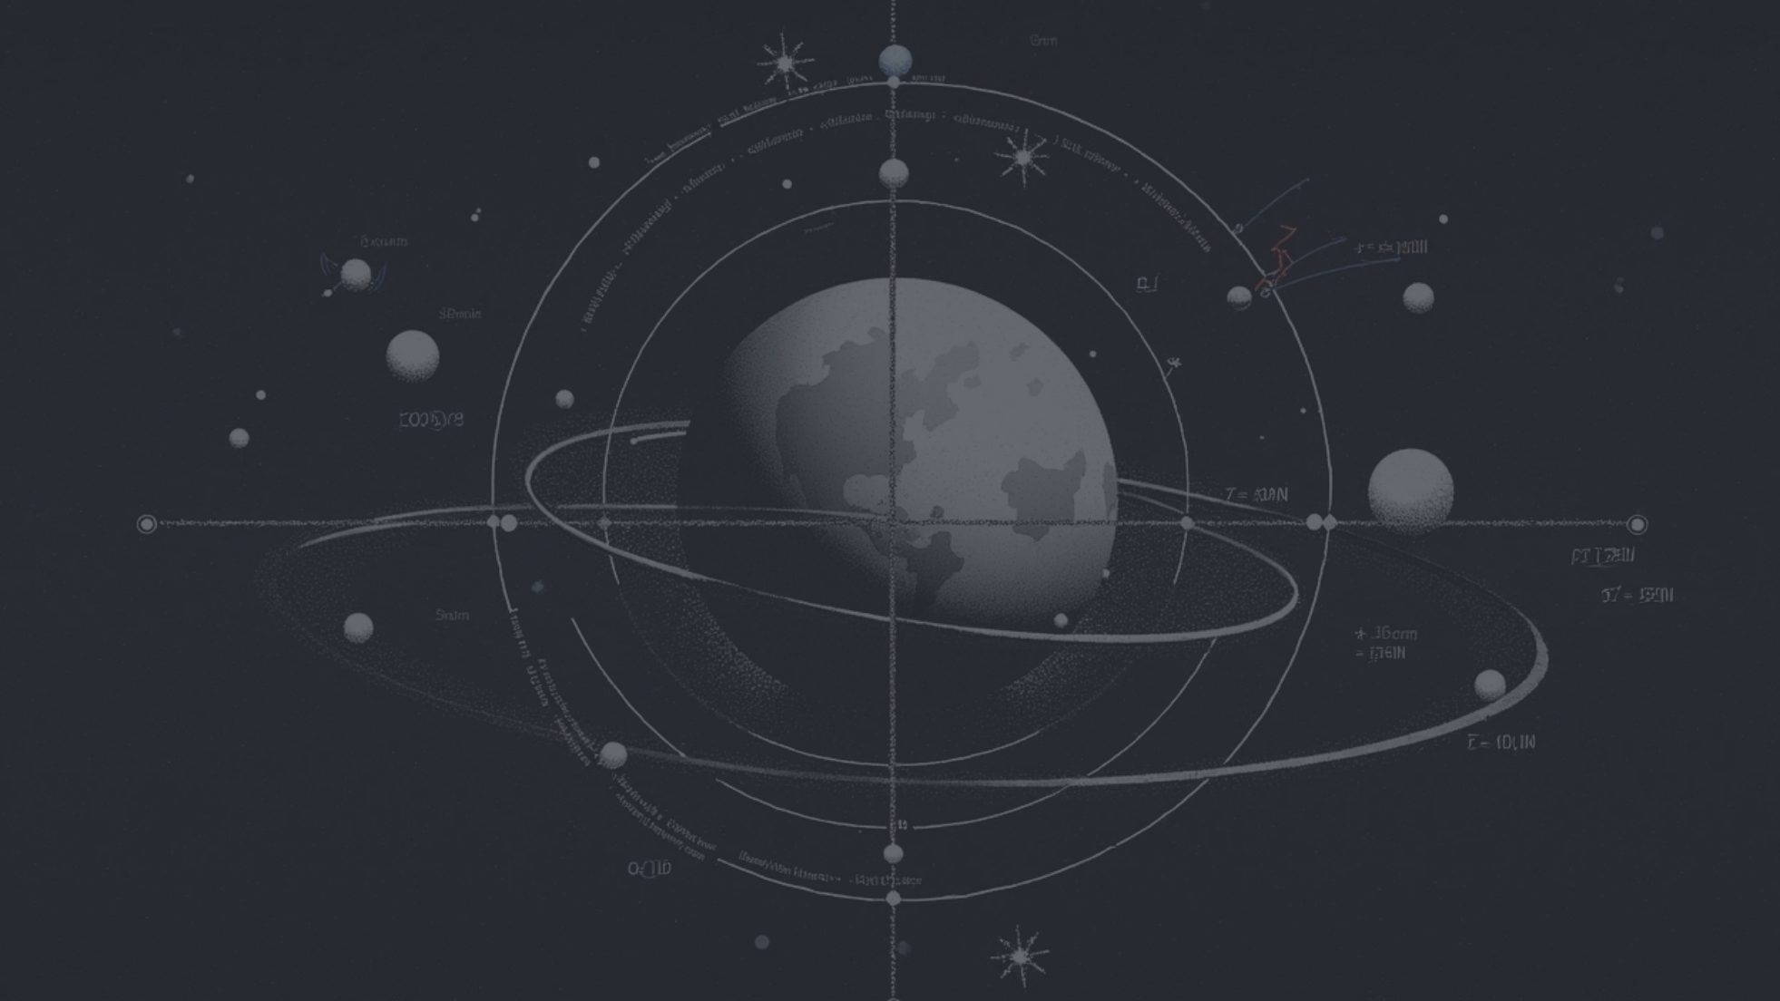



Calculating Ecliptic Coordinates
1
Conversion from Equatorial Coordinates
2
Use of Mathematical Functions
3
Tools and Software
Astronomical software and tools assist in real-time computations of ecliptic coordinates, making it easier for researchers to visualize celestial movements.
Ecliptic coordinates can be derived from equatorial coordinates through mathematical transformations, involving the inclination of the ecliptic.
Functions like sine and cosine are employed in calculations to convert between these systems, aiding in precision for locating celestial objects.

Slide 5




Applications in Astronomy
Planetary Motion
Celestial Events
Satellite Orbital Dynamics
Ecliptic latitude and longitude are fundamental for understanding the motion of planets and their interactions within the solar system.
These coordinates are crucial for predicting celestial events like eclipses and transits, influencing observational strategies in astronomy.
Satellites and spacecraft utilize ecliptic coordinates for navigation, ensuring accurate positioning relative to solar and planetary bodies.

Slide 6




Visualizing Ecliptic Coordinates
Visualizing ecliptic coordinates helps in understanding celestial movements and positioning through various methods such as maps, animations, and simulations.
Animation Tools
Animated graphics can demonstrate the movement of planets along ecliptic paths over time, highlighting the significance of this coordinate system visually.
2
Celestial Maps
Visual representations of the ecliptic coordinate system, including diagrams that illustrate ecliptic latitude and longitude, enhance comprehension of celestial positioning.
1
Educational Simulations
Interactive models and simulations enable students and enthusiasts to explore the concept of ecliptic coordinates effectively, facilitating deeper understanding.
3

Slide 7

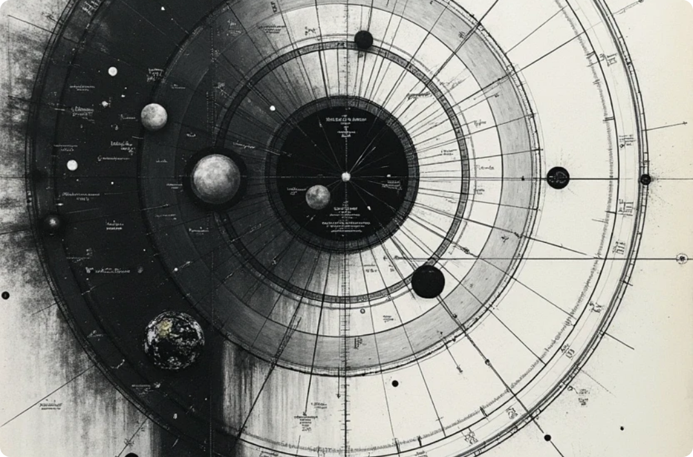


Challenges and Future Directions
Complex Orbital Dynamics
Technological Advances
Interdisciplinary Studies
Variations in celestial mechanics and gravitational influences pose challenges in accurately predicting ecliptic coordinates over extended periods.
Ongoing advancements in observational technology and data processing enhance our ability to calculate and utilize ecliptic coordinates more effectively.
The integration of fields like astrophysics and astrobiology with ecliptic studies may yield new insights into the dynamics of the solar system and the potential for extraterrestrial life.

Slide 8

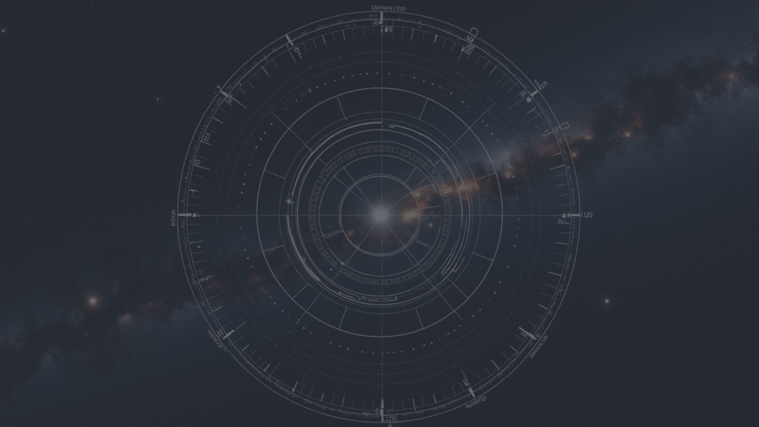



Conclusion on Ecliptic Coordinates
1
2
3
Eclipsic Coordinates' Relevance
Continuing Research
Educational Importance
Ecliptic latitude and longitude are integral to modern astronomy for mapping celestial objects and understanding their movements.
As technology evolves, further exploration of these coordinates will enhance our comprehension of the universe and its myriad phenomena.
Promoting awareness of ecliptic coordinates in educational settings will inspire future generations of astronomers and scientists.

